Slide 1

Welcome to
Deep Learning
By: Ahmed Haytham
2021-2022

Slide 2

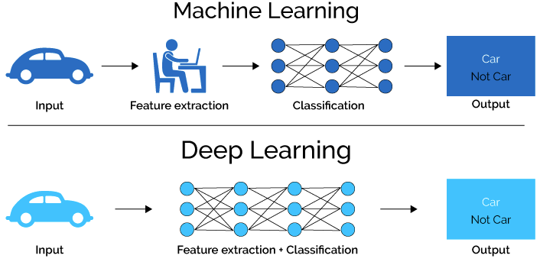
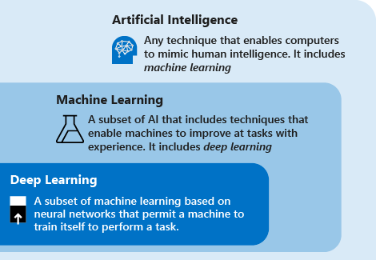
DL vs ML

Slide 3
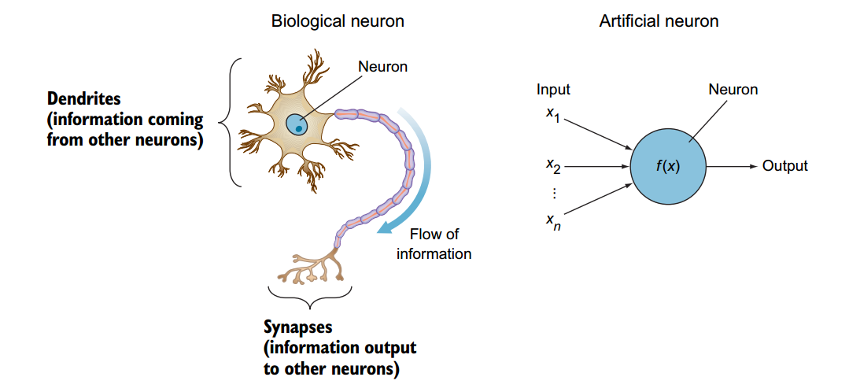
perceptrons
The most simple neural network which consists of a single neuron
the perceptron functions in a manner similar to a biological neuron. A biological neuron receives electrical signals from its dendrites, modulates the electrical signals in various amounts, and then fires an output signal through its synapses only when the total strength of the input signals exceeds a certain threshold. The output is then fed to another neuron, and so forth

Slide 4
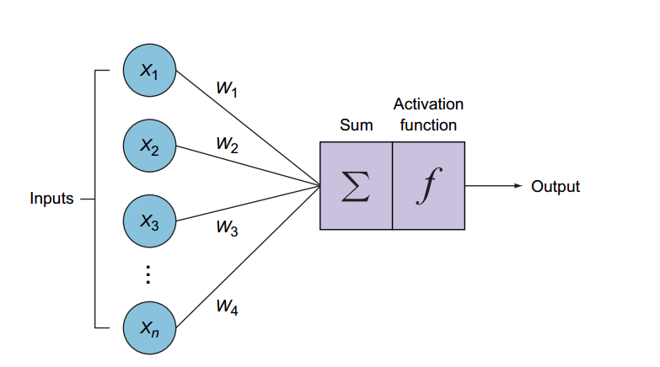
perceptrons
To model / simulate the biological neuron phenomenon
the artificial neuron performs two consecutive functions
calculates the weighted sum of the inputs
to represent the total strength of the input
applies a step function to the result
Determine whether to fire the output 1 if the signal exceeds a certain threshold or 0 if the signal doesn’t exceed the threshold
What is ‘W’
Deeper look in sum

Slide 5
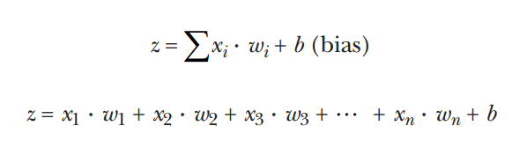
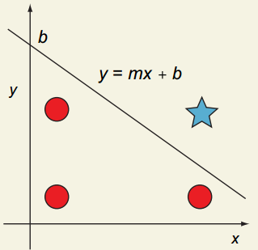
Connection weights
WEIGHTED SUM FUNCTION
perceptrons
Each input feature (xi) is assigned its own weight (wi) that reflects its importance in the decision-making process
Also known as a linear combination, the weighted sum function is the sum of all inputs multiplied by their weights, and then added to a bias term
bias
Bias allows you to move
the line up and down on the y-axis to better fit the prediction with the data. Without
the bias (b), the line always has to go through the origin point (0,0)

Slide 6
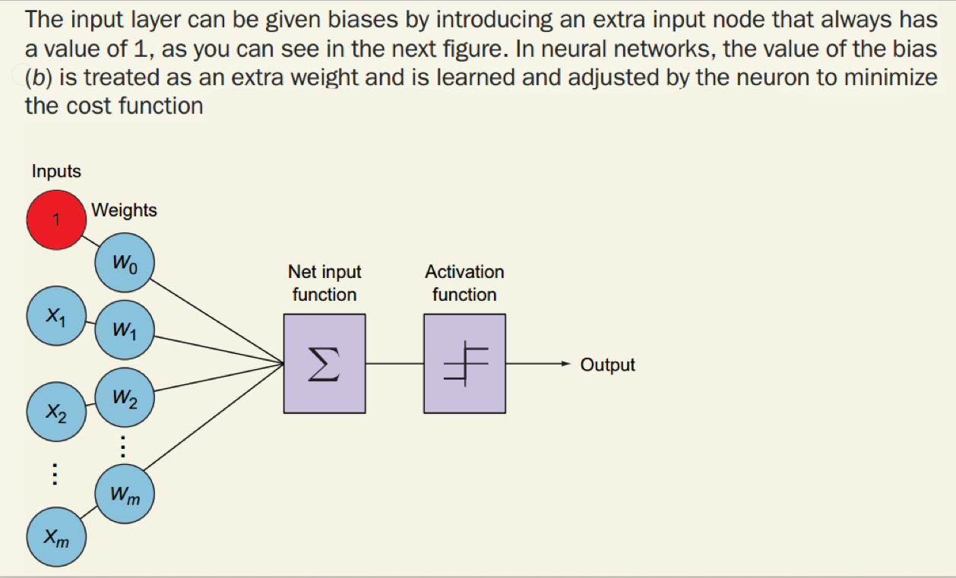

Slide 7
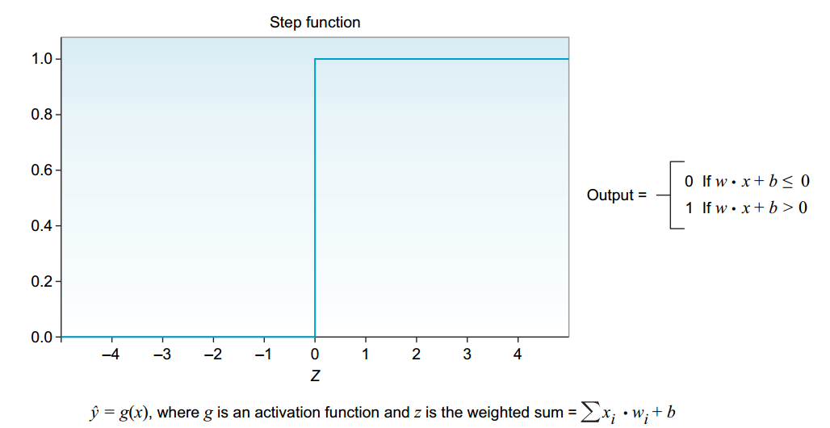
STEP ACTIVATION FUNCTION
perceptrons
In both artificial and biological neural networks, a neuron does not just output the bare input it receives. Instead, there is one more step, called an activation function; this is the decision-making unit of the brain
The simplest activation function used by the perceptron algorithm is the
step function that produces a binary output (0 or 1). It basically says that if the
summed input ≥ 0, it “fires” (output = 1); else (summed input < 0), it doesn’t fire (output = 0)

Slide 8
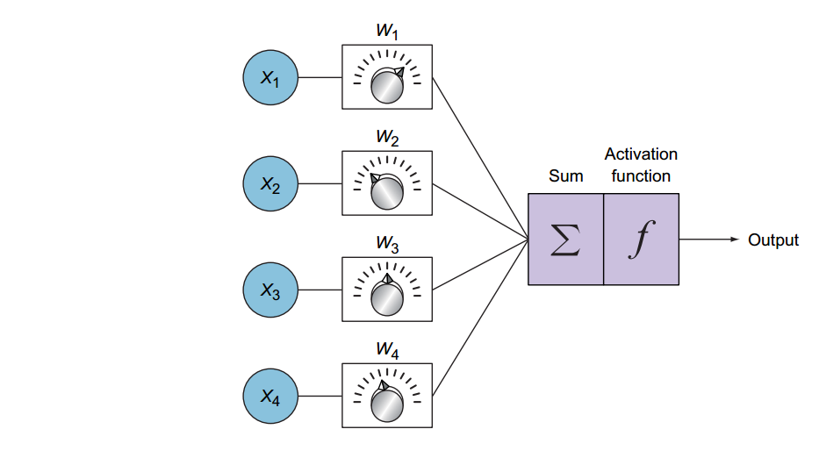
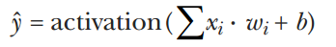
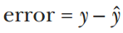
Perceptron Learning
perceptrons
The neuron calculates the weighted sum and applies the activation function to make a prediction yˆ. This is called the feedforward process
It compares the output prediction with the correct label to calculate the error:
It then updates the weight. If the prediction is too high, it adjusts the weight to make a lower prediction the next time, and vice versa.
Repeat!

Slide 9
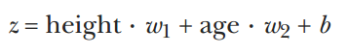
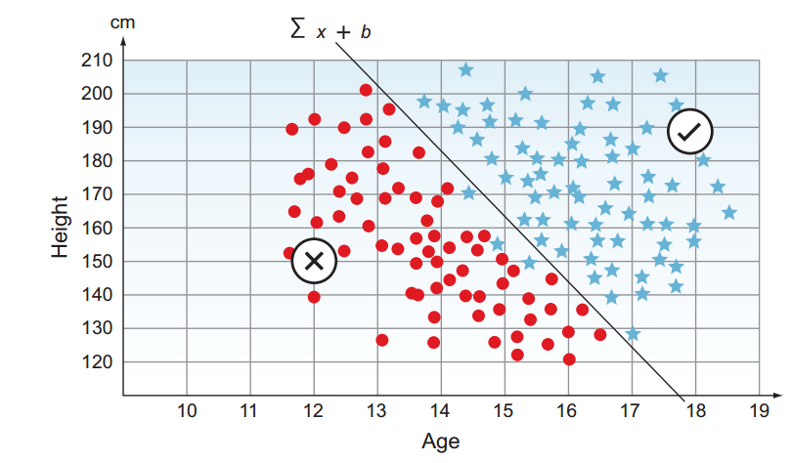
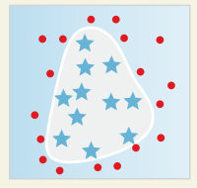
Perceptrons limits
perceptrons
players will be accepted based on only two features (height and age).
What IF?

Slide 10
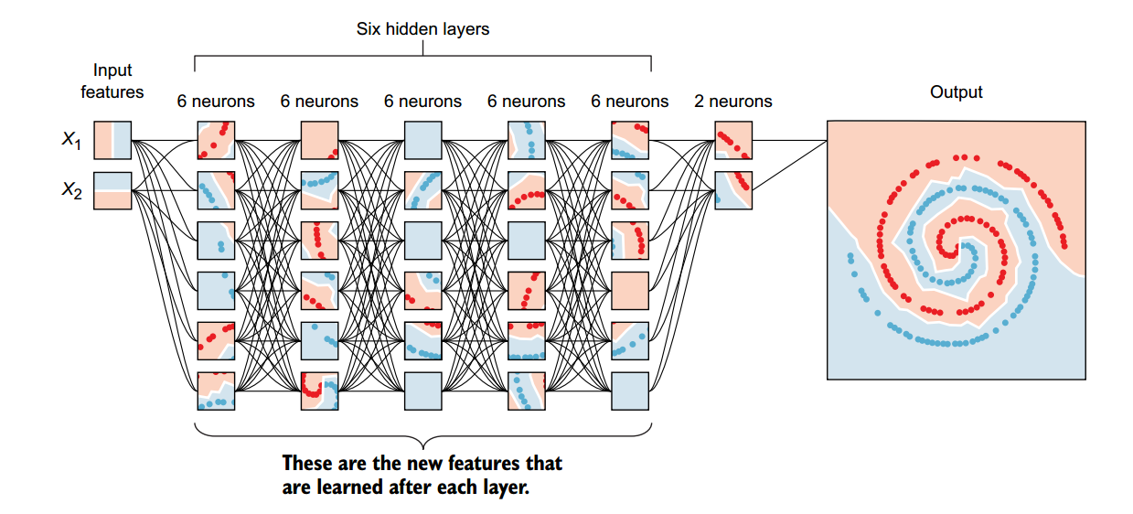
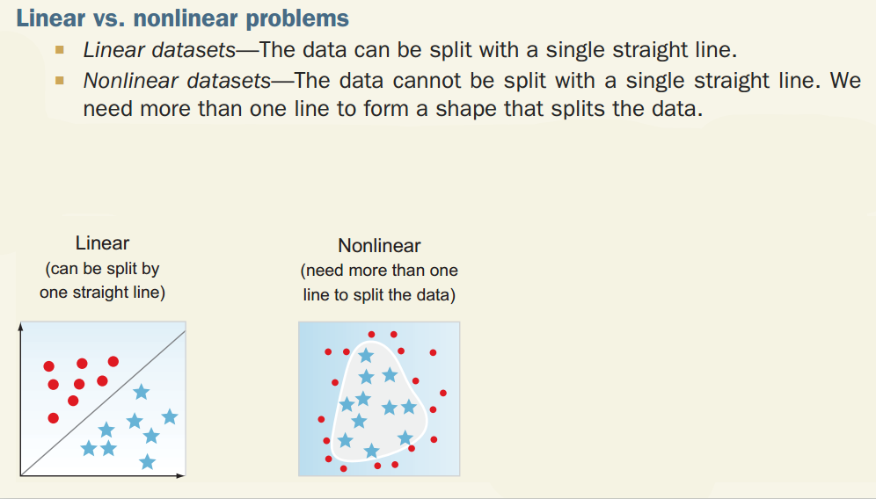
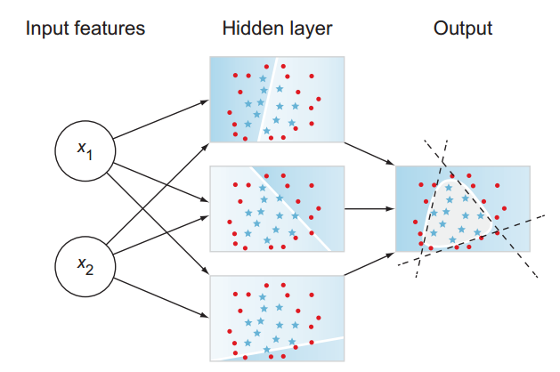
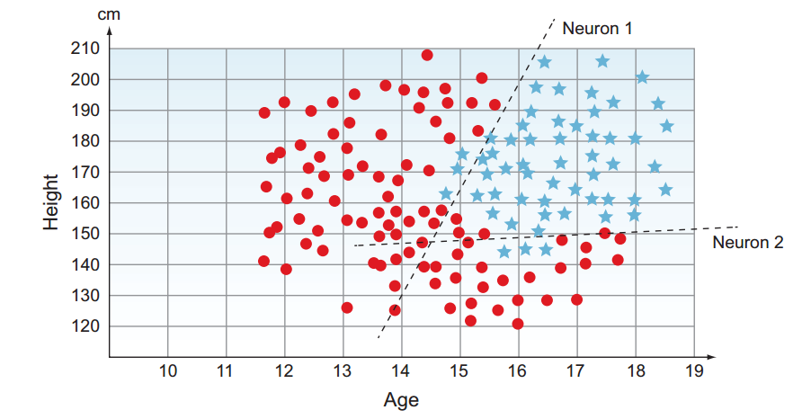

Multilayer perceptrons
Add one more perceptrons This would produce two lines. Would that help us separate the data better?

Slide 11
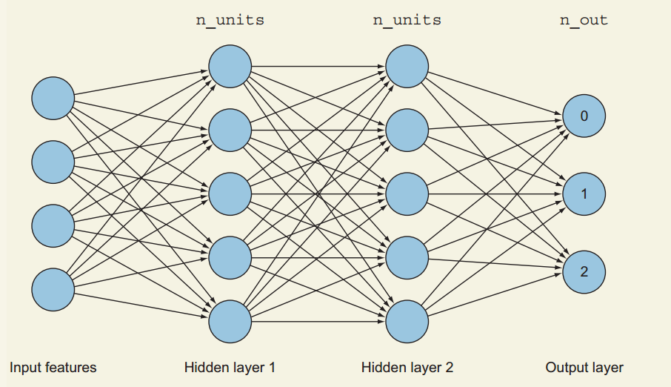
Multilayer perceptrons
What are hidden layers?
This is where the core of the feature-learning process takes place

Slide 12
Activation functions
When you are building your neural network, one of the design decisions that you will need to make is what activation function to use for your neurons
They transform the linear combination of a weighted sum into a nonlinear model
An activation function is placed at the end of each perceptron to decide whether to activate this neuron.
Why the activation functions?
Activation functions are needed to restrict the output value to a certain finite value

Slide 13
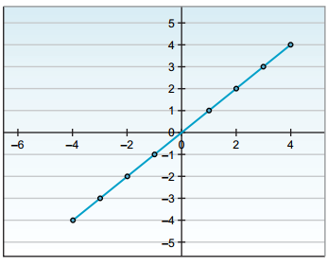
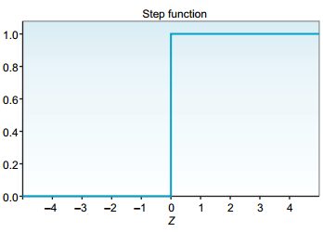
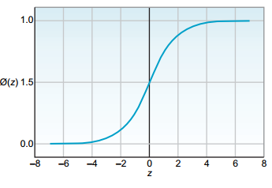
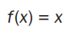
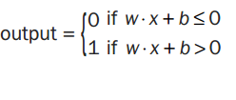
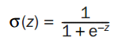
Activation functions
1_ Linear transfer function (identity function)
The signal passes through it unchanged. It remains a linear function. Almost never used
2_Heaviside step function (binary classifier)
Produces a binary output of 0 or 1.Mainly used in binary classification to give a discrete value.
3_Sigmoid / Logistic function
Squishes all the values to a probability between 0 and 1, which reduces extreme values or outliers in the data. Usually used to classify two classes

Slide 14
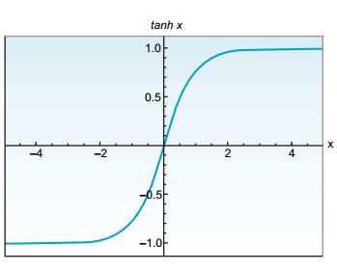
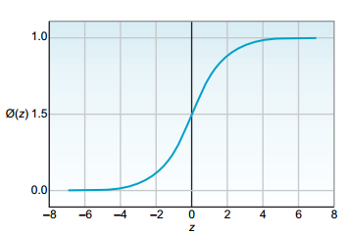
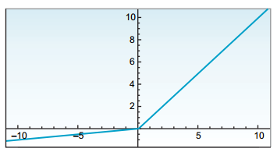
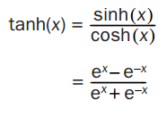
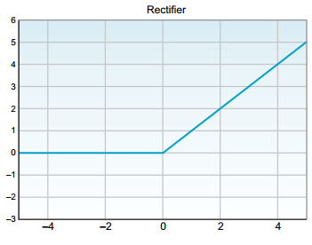
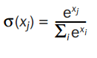
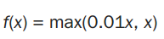
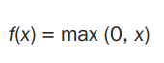
Activation functions
4_ Softmax function
A generalization of the sigmoid function. Used to obtain classification probabilities when we have more than two classes.
5_Hyperbolic tangent function (tanh)
Squishes all values to the range of –1 to 1. Tanh almost always works better than the sigmoid function in hidden layers
6_Rectified linear unit(ReLU)
Activates a node only if the input is above zero. Always recommended for hidden layers. Better than tanh
7_Leaky ReLU
Instead of having the function be zero when x < 0, leaky ReLU introduces a small negative slope (around 0.01) when (x) is negative

Slide 15
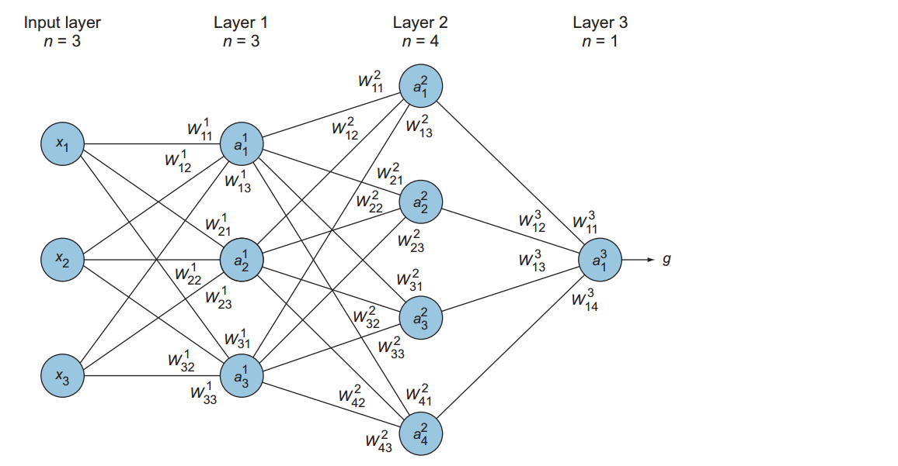
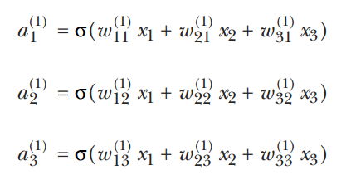
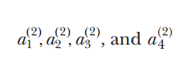
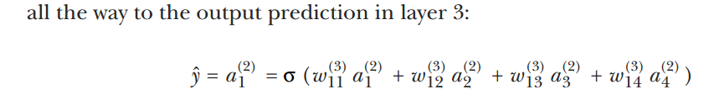
The feedforward process
The process of computing the linear combination and applying the activation function

Slide 16
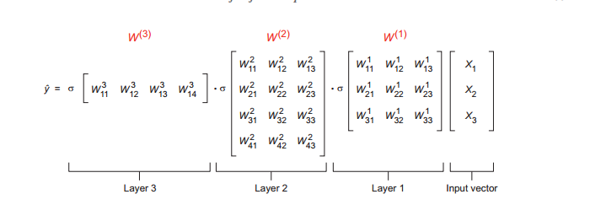

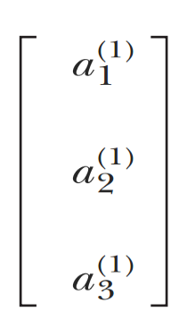
The feedforward process
The process of computing the linear combination and applying the activation function
sum = [(X1.W13)+(X2.W23)+(X3.W33)]
(1)
1
a = sigmod (sum)

Slide 17
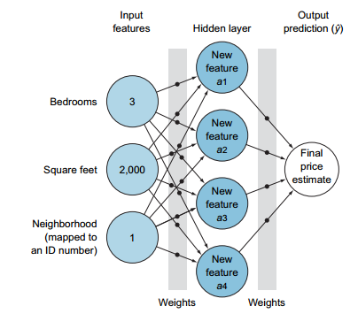
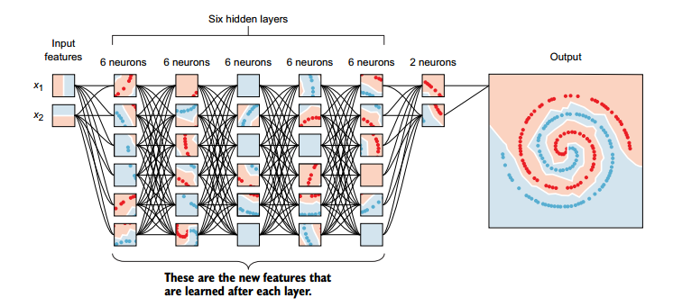
Feature learning
The nodes in the hidden layers (ai) are the new features that are learned after each layer

Slide 18
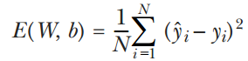
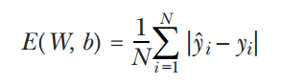
Error function
The error function is a measure of how “wrong” the neural network prediction is
In optimization problems, our ultimate goal is to find the optimum variables (weights) that would minimize the error function
Error is always positive
suppose we have two data points that we are trying to get our network to predict correctly. If the first gives an error of 10 and the second gives an error of –10, then our average error is zero! This is misleading because “error = 0”
Mean square error
is commonly used in regression problems that require the output to be a real value (like house pricing)
The square ensures the error is always positive
sensitive to outliers

Slide 19
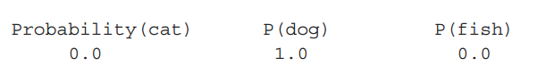
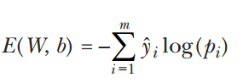
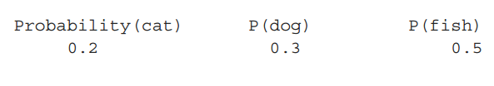

Error function
The error function is a measure of how “wrong” the neural network prediction is
Cross-entropy
Cross-entropy is commonly used in classification problems because it quantifies the difference between two probability distributions
Real value
Predicted value

Slide 20
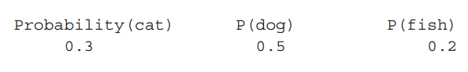

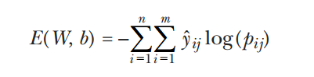
Error function
The error function is a measure of how “wrong” the neural network prediction is
Predicted value 2

Slide 21
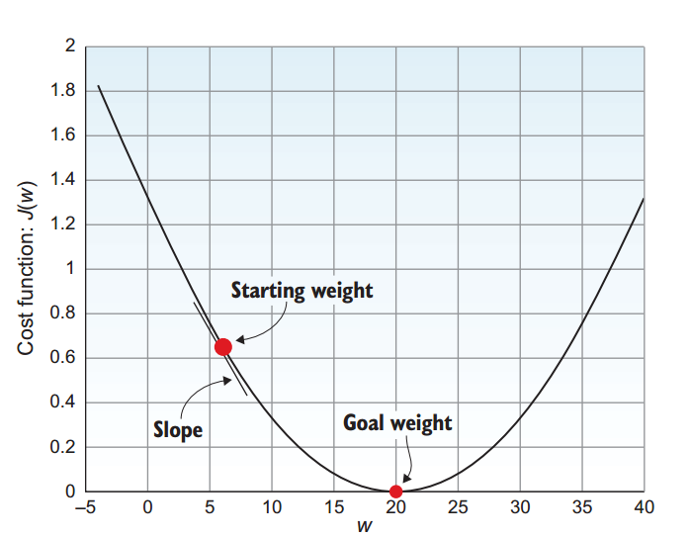
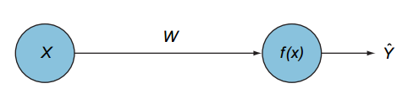
optimization
Optimization is a way of framing a problem to maximize or minimize some value
In neural networks, optimizing the error function means updating the weights and biases until we find the optimal weights, or the best values for the weights to produce the minimum error
Brute-force ?
a perceptron with one input

Slide 22


optimization
Optimization is a way of framing a problem to maximize or minimize some value
Batch gradient descent
A gradient is the function that describes the rate of change of the line that is tangent to a curve at any given point.
Gradient descent simply means updating the weights iteratively to descend the slope of the error curve until we get to the point with minimum error

Slide 23

optimization
THE DIRECTION (GRADIENT)
Suppose you are standing on the top of the error mountain at point A. To get to the bottom, you need to determine the step direction that results in the deepest descent (has the steepest slope)
THE STEP SIZE (LEARNING RATE α)
The learning rate is the size of each step the network takes when it descends the error mountain, and it is usually denoted by the Greek letter alpha (α)

Slide 24

optimization
PITFALLS OF BATCH GRADIENT DESCENT
1_Complex error functions are represented by more complex curves with many local minima values. Our goal is to reach the global minimum value.
2_batch gradient descent uses the entire training set to compute the gradients at every step
100,000,000 (100 million) records, the algorithm needs to sum over 100 million records just to take one step

Slide 25

optimization
Stochastic = random gradient descent (SGD)
stochastic gradient descent, the algorithm randomly selects data points and goes through the gradient descent one data point at a time
SGD randomly picks one instance
in the training set for each one step and calculates the gradient based only on that single instance

Slide 26

Mini-batch gradient descent
compromise between BGD and SGD. Instead of computing the gradient from one sample (SGD) or all samples (BGD), we divide the training sample into mini-batches

Slide 27

Backpropagation
Backpropagation is the core of how neural networks learn

Slide 28



Backpropagation

Slide 29

Thank you.
Very much!

